Slide 1
CS F301: Principles of Programing Languages

Slide 2
Concurrent Programming: Threads, Synchronization features(semaphores, monitors, locks), Shared Memory

Slide 3
Concurrent Programming
Until now: execution involved one flow of control through program
Concurrent programming is about programs with multiple flows of control
For example: a program that runs as multiple processes cooperating to achieve a common goal
To cooperate, processes must somehow communicate
Sources (Slide 3 to 26):
https://www.cs.uic.edu/~jbell/CourseNotes/OperatingSystems
http://cds.iisc.ac.in/faculty/vss/courses/HPC

Slide 4
Inter-process Communication
IPC stands for Inter-process Communication.
Different Types of IPCS
There are various IPC’s which allows a process to communicate with another processes, either in the same computer or different computer in the same network.
Pipes – Provides a way for processes to communicate with each another by exchanging messages. Named pipes provide a way for processes running on different computer systems to communicate over the network.
Shared Memory – Processes can exchange values in the shared memory. One process will create a portion of memory which other process can access.
Message Queue – It is a structured and ordered list of memory segments where processes store or retrieve data.
Semaphores – Provides a synchronizing mechanism for processes that are accessing the same resource. No data is passed with a semaphore; it simply coordinates access to shared resources.

Slide 5
LINUX SYSTEM – IPC Command

Slide 6
Inter Process Communication (IPC)
Using files
Parent process creates 2 files before forking child process
Child inherits file descriptors from parent, and they share the file pointers
Can use one for parent to write and child to read, other for child to write and parent to read
Processes could communicate through variables that are shared between them
Shared variables, shared memory; other variables are private to a process
Special OS support for program to specify objects that are to be in shared regions of address space

Slide 7
Inter Process Communication (IPC)
Sometimes processes don’t need to communicate explicit values to cooperate
They might just have to synchronize their activities
Example: Process 1 reads 2 matrices, Process 2 multiplies them, Process 3 writes the result matrix
Process 2 should not start work until Process 1 finishes reading, etc.
Called process synchronization
Synchronization primitives
Examples: mutex lock, semaphore, monitors

Slide 8
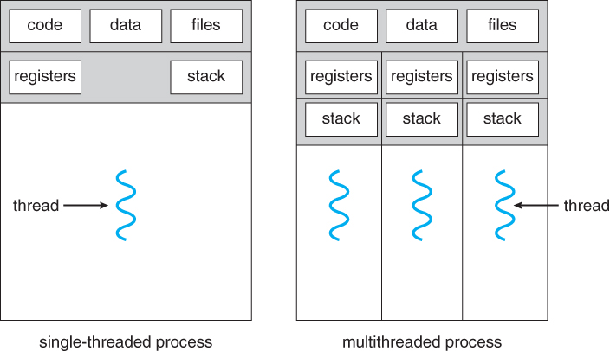
Threads
A thread is a basic unit of CPU utilization, consisting of a program counter, a stack, and a set of registers, ( and a thread ID. )
Traditional ( heavyweight ) processes have a single thread of control - There is one program counter, and one sequence of instructions that can be carried out at any given time.
Example:
In a word processor, a background thread may check spelling and grammar while a foreground thread processes user input ( keystrokes ), while yet a third thread loads images from the hard drive, and a fourth does periodic automatic backups of the file being edited.
Another example is a web server - Multiple threads allow for multiple requests to be satisfied simultaneously, without having to service requests sequentially or to fork off separate processes for every incoming request.

Slide 9
Threads
There are four major categories of benefits to multi-threading:
Responsiveness - One thread may provide rapid response while other threads are blocked or slowed down doing intensive calculations.
Resource sharing - By default threads share common code, data, and other resources, which allows multiple tasks to be performed simultaneously in a single address space.
Economy - Creating and managing threads ( and context switches between them ) is much faster than performing the same tasks for processes.
Scalability, i.e. Utilization of multiprocessor architectures - A single threaded process can only run on one CPU, no matter how many may be available, whereas the execution of a multi-threaded application may be split amongst available processors.

Slide 10
Multithreading Models
There are two types of threads to be managed in a modern system: User threads and kernel threads.
User threads are supported above the kernel, without kernel support. These are the threads that application programmers would put into their programs.
Kernel threads are supported within the kernel of the OS itself. All modern OSes support kernel level threads, allowing the kernel to perform multiple simultaneous tasks and/or to service multiple kernel system calls simultaneously.
In a specific implementation, the user threads must be mapped to kernel threads, using one of the following strategies.
Many to one: Word Processor Application
One to one: Windows 95 to Windows XP, DOS
Many to many: Linux, Solaris

Slide 11
Thread Libraries
Thread libraries provide programmers with an API for creating and managing threads.
Thread libraries may be implemented either in user space or in kernel space.
The former involves API functions implemented solely within user space, with no kernel support.
The latter involves system calls, and requires a kernel with thread library support.
There are three main thread libraries in use today:
POSIX Pthreads - may be provided as either a user or kernel library, as an extension to the POSIX standard.
Win32 threads - provided as a kernel-level library on Windows systems.
Java threads - Since Java generally runs on a Java Virtual Machine, the implementation of threads is based upon whatever OS and hardware the JVM is running on, i.e. either Pthreads or Win32 threads depending on the system. (API: synchronised, suspend(), resume(), join(),wait(), notify(),notifyall())

Slide 12
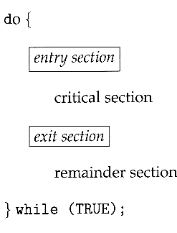
Critical-Section Problem
The critical section is a code segment where the shared variables can be accessed.
The general idea is that in a number of cooperating processes, each has a critical section of code, with the following conditions and terminologies:
Only one process in the group can be allowed to execute in their critical section at any one time. If one process is already executing their critical section and another process wishes to do so, then the second process must be made to wait until the first process has completed their critical section work.
The code preceding the critical section, and which controls access to the critical section, is termed the entry section. It acts like a carefully controlled locking door.
The code following the critical section is termed the exit section. It generally releases the lock on someone else's door, or at least lets the world know that they are no longer in their critical section.
The rest of the code not included in either the critical section or the entry or exit sections is termed the remainder section.

Slide 13
Critical-Section Problem
A solution to the critical section problem must satisfy the following three conditions:
Mutual Exclusion - Only one process at a time can be executing in their critical section.
Progress - If no process is currently executing in their critical section, and one or more processes want to execute their critical section, then only the processes not in their remainder sections can participate in the decision, and the decision cannot be postponed indefinitely. ( i.e. processes cannot be blocked forever waiting to get into their critical sections. )
Bounded Waiting - There exists a limit as to how many other processes can get into their critical sections after a process requests entry into its critical section and before that request is granted. ( I.e. a process requesting entry into their critical section will get a turn eventually, and there is a limit as to how many other processes get to go first. )

Slide 14
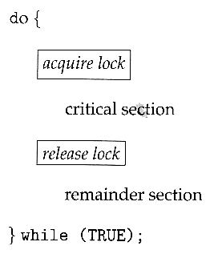
Mutex Lock
Mutex Lock: a synchronization primitive
The terminology when using mutexes is to acquire a lock prior to entering a critical section, and to release it when exiting,
Acquire Lock
Done before critical section of code
Returns when safe for process to enter critical section
Release Lock
Done after critical section
Allows another process to acquire lock

Slide 15
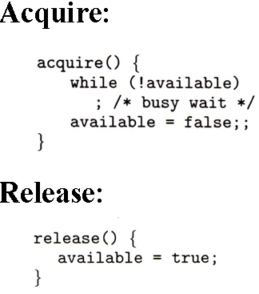
Mutex Lock
Acquire and release can be implemented as shown here, based on a boolean variable "available“ (as shown in figure).
One problem with the implementation shown here, is the busy loop used to block processes in the acquire phase. These types of locks are referred to as spinlocks, because the CPU just sits and spins while blocking the process.
Spinlocks are wasteful of cpu cycles, and are a really bad idea on single-cpu single-threaded machines, because the spinlock blocks the entire computer, and doesn't allow any other process to release the lock.
On the other hand, spinlocks do not incur the overhead of a context switch, so they are effectively used on multi-threaded machines when it is expected that the lock will be released after a short time.

Slide 16
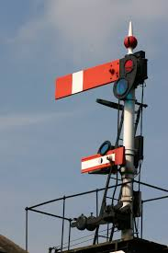
Semaphores
Semaphores can best be described as counters used to control access to shared resources by multiple processes.
They are most often used as a locking mechanism to prevent processes from accessing a particular resource while another process is performing operations on it.
Semaphore is actually an old railroad term, referring to the crossroad ``arms'' that prevent cars from crossing the tracks at intersections.
The same can be said about a simple semaphore set. If the semaphore is on (the arms are up), then a resource is available (cars may cross the tracks).
However, if the semaphore is off (the arms are down), then resources are not available (the cars must wait).

Slide 17
Semaphores
Semaphores are actually implemented as sets.
A given semaphore set can have one semaphore (railroad example) or more semaphores.
Another approach: think of semaphores as resource counters.
Another real world scenario: Consider a print spooler, capable of handling multiple printers.
Each printer handling multiple print requests.
A print spool manager will utilize semaphore sets to monitor access to each printer.
Assume in our print room, we have 5 printers online.
Our print spool manager allocates a semaphore set with 5 semaphores in it, one for each printer on the system.
Since each printer is only physically capable of printing one job at a time, each of our five semaphores in our set will be initialized to a value of 1 (one), meaning that they are all online, and accepting requests.

Slide 18
Semaphores
John sends a print request to the spooler.
The print manager looks at the semaphore set, and finds the first semaphore which has a value of one.
Before sending John's request to the physical device, the print manager decrements the semaphore for the corresponding printer. (i.e. -1).
Now, that semaphore's value is zero.
A value of zero represents 100% resource utilization on that semaphore. In our example, no other request can be sent to that printer until it is no longer equal to zero.
When John's print job has completed, the print manager increments the value of the semaphore which corresponds to the printer. Its value is now back up to one (1), which means it is available again.
Naturally, if all 5 semaphores had a value of zero, that would indicate that they are all busy printing requests, and that no printers are available.

Slide 19
Semaphores
Semaphores, when thought of as resource counters, may be initialized to any positive integer value, and are not limited to either being zero or one.
If it were possible for each of our five printers to handle 10 print jobs at a time, we could initialize each of our semaphores to 10, decrementing by one for every new job, and incrementing by one whenever a print job was finished.
Semaphores have a close working relationship with shared memory segments, acting as a watchdog to prevent multiple writes to the same memory segment.

Slide 20

Dining-Philosophers Problem
The dining philosophers problem is a classic synchronization problem involving the allocation of limited resources amongst a group of processes in a deadlock-free and starvation-free manner:
Consider five philosophers sitting around a table, in which there are five chopsticks evenly distributed and an endless bowl of rice in the center, as shown in the diagram below. ( There is exactly one chopstick between each pair of dining philosophers. )
These philosophers spend their lives alternating between two activities: eating and thinking.
When it is time for a philosopher to eat, it must first acquire two chopsticks - one from their left and one from their right.
When a philosopher thinks, it puts down both chopsticks in their original locations.

Slide 21
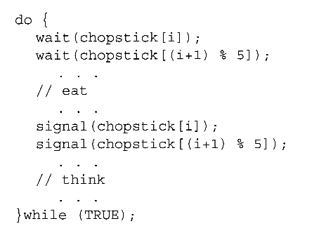
Possible solution to Dinning Philosophers
One possible solution, as shown in the following code section, is to use a set of five semaphores ( chopsticks[ 5 ] ), and to have each hungry philosopher first wait on their left chopstick ( chopsticks[ i ] ), and then wait on their right chopstick ( chopsticks[ ( i + 1 ) % 5 ] ).
But suppose that all five philosophers get hungry at the same time, and each starts by picking up their left chopstick. They then look for their right chopstick, but because it is unavailable, they wait for it, forever, and eventually all the philosophers starve due to the resulting deadlock.

Slide 22
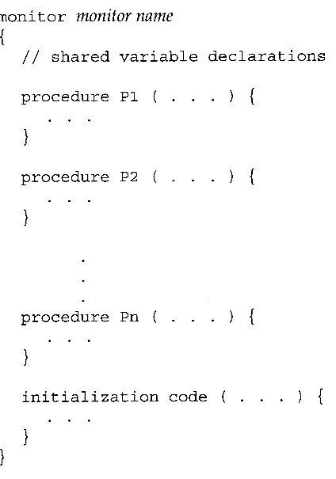
Monitor
A monitor is essentially a class, in which all data is private, and with the special restriction that only one method within any given monitor object may be active at the same time.
An additional restriction is that monitor methods may only access the shared data within the monitor and any data passed to them as parameters. I.e. they cannot access any data external to the monitor.
Example: Transaction on Bank Account

Slide 23
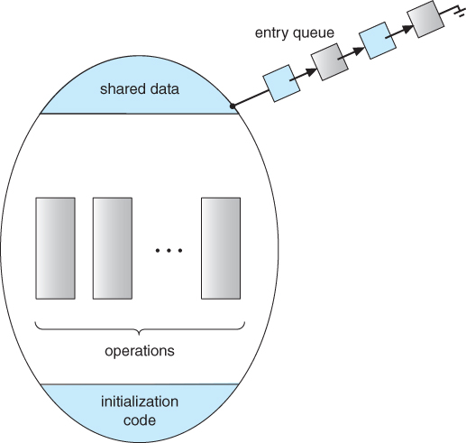
Monitor
A schematic of a monitor, with an entry queue of processes waiting their turn to execute monitor operations ( methods. )

Slide 24
Monitor
In order to fully realize the potential of monitors, we need to introduce one additional new data type, known as a condition.
A variable of type condition has only two legal operations, wait and signal. I.e. if X was defined as type condition, then legal operations would be X.wait( ) and X.signal()
The wait operation blocks a process until some other process calls signal, and adds the blocked process onto a list associated with that condition.
The signal process does nothing if there are no processes waiting on that condition. Otherwise it wakes up exactly one process from the condition's list of waiting processes.

Slide 25
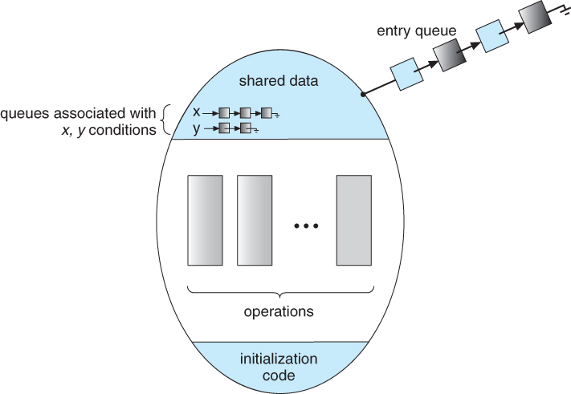
Monitor
Figure illustrates a monitor that includes condition variables within its data space.
Note that the condition variables, along with the list of processes currently waiting for the conditions, are in the data space of the monitor - The processes on these lists are not "in" the monitor, in the sense that they are not executing any code in the monitor.

Slide 26
Problem with Monitor
If process P within the monitor issues a signal that would wake up process Q also within the monitor, then there would be two processes running simultaneously within the monitor, violating the exclusion requirement.
Accordingly there are two possible solutions to this dilemma:
Signal and wait - When process P issues the signal to wake up process Q, P then waits, either for Q to leave the monitor or on some other condition.
Signal and continue - When P issues the signal, Q waits, either for P to exit the monitor or for some other condition.

Slide 27
Dining-Philosophers Solution Using Monitors
This solution imposes the restriction that a philosopher may pick up her chopsticks only if both of them are available.
Consider the threes states of philosopher to implement a solution:
THINKING – When philosopher doesn’t want to gain access to either fork.
HUNGRY – When philosopher wants to enter the critical section.
EATING – When philosopher has got both the forks, i.e., he has entered the section.
Condition: Philosopher i can set the variable state[i] = EATING only if her two neighbours are not eating (state[(i+4) % 5] != EATING) and (state[(i+1) % 5] != EATING).
Complete Solution

Slide 28
Thank you

